Slide 1
Active Learning Community for Upskilling Technicians and Engineers
PROGRAM: ERASMUS+ Key Activity 2
Project number: 2020-1-BG01-KA202-079042
Duration: 01.09.2020 – 31.08.2022

Slide 2
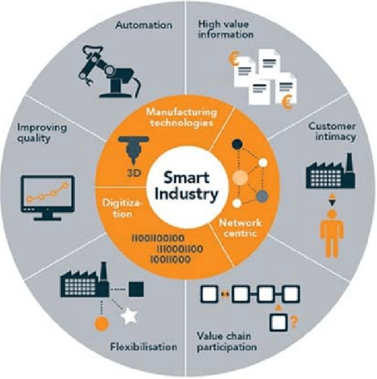
INDUSTRY 4.0
Cyber physical systems
Internet of services IoS
Internet of thing IoT
Machine learning

Slide 3
PROFILE OF A WORKER 4.0
Adaptive skills
embracing technology;
mindset change.
Transversal skills
innovative thinking;
decision making;
communication and collaboration;
respect for the environment, etc.
Technical skills
automation systems;
energy optimization and sustainability;
systems engineering.
Technological skills
smart engineering;
smart infrastructure;
data analysis;
cyber security;
integrated platforms.

Slide 4
SKILL GAPS OF THE CURRENT WORKFORCE
MEASURES TO COUNTERACT THESE GAPS
TALENT GAP
ONGOING TRAINING AND RETRAINING
LOW LEVEL OF TRANSVERSAL SKILLS
ACTIVE AND PROBLEM-BASED LEARNING
LOW LEVEL OF DIGITAL SKILLS
BLENDED LEARNING AND E-LEARNING

Slide 5
OUR PROPOSAL FOR SOLUTION
Project Active Learning Community for Upskilling Technicians and Engineers
addresses
the workforce that will be most affected by Industry 4.0
Engineers
Technicians
in the sector of Machine Building and Mechatronics
VET trainers
VET providers
Companies
Universities and Chambers

Slide 6
MAIN PROJECT OUTCOMES
Teacher’s ToolKit on Active and Problem-based Learning. It is an attempt to tackle the transversal skills’ gap.
Survey on the skills deficit of technical and engineering staff in the sector of Machine Building and Mechatronics.
Curriculum for upskilling technicians and engineers in the sector of Machine Building and Mechatronics.
14 course materials (PPT presentations, industry-related problems and additional internet resources) as open educational resources. It is an attempt to tackle the talent and transversal skills’ gap.
Problem-based platform – industry-relevant problems; a discussion forum for tutor and peer-to-peer support; assessment area for assessing the gained knowledge. It is an attempt to tackle the transversal and digital skills’ gap.
1
2
3
4
5

Slide 7
EXPECTED PROJECT IMPACT
Technicians Engineers
VET trainers and providers
Chambers
Universities
Companies
upskilled engineering skills;
improved transversal and digital skills;
access to open online TVET resources tailored to their needs;
securing their positions and future career development.
improved teaching competence by mastering active learning techniques and strategically using ICT;
ability to better motivate learners;
access to TVET resources.
awareness of the specific TVET needs of their engineers / technicians;
upskilled technicians and engineers
opportunity to adequately meet the demands of Industry 4.0;
potential of higher economic growth.
awareness of the specific TVET needs of technicians and engineers;
access to open online TVET educational resources;
training of their teachers on active learning techniques;
providing TVET to companies.

Slide 8
PROJECT PARTNERSHIP – STRONGER TOGETHER
COORDINATOR:
Technical University of Gabrovo, Bulgaria
PARTNERS:
Cluster Trakia Economic Zone, Bulgaria
Gabrovo Chamber of Commerce and Industry, Bulgaria
International Hellenic University, Greece
Kavala Chamber of Commerce, Greece
Gdansk University of Technology, Poland
Regional Chamber of Commerce, Gdansk, Poland
University of Nis, Serbia
Serbian Chamber of Commerce, Serbia

Slide 9
FOLLOW US
ALLCUTE.EU
The European Commission's support for the production of this publication does not constitute an endorsement of the contents, which reflect the views only of the authors, and the Commission cannot be held responsible for any use which may be made of the information contained therein.

